Slide 1
CS 31006: Computer Networks – Moving From End-to-End To Per Hop

Slide 2
What We Have Learnt So Far …
The design of current network architecture is based on experience and requirements
Data Link
Physical
Physical
Transport
Network
Network
Data Link
Data Link
Physical
Physical

Slide 3
What We Have Learnt So Far …
Protocol stack is implemented across different layers of the operating system
Application
Software, Kernel
Transport
Network
Data Link
Firmware, Device Driver
Physical
Hardware

Slide 4
Network (Internet) Layer Services
UDP
TCP
End to end packet delivery
Connection Establishment
Reliable Data Delivery
Flow and Congestion Control
Ordered Packet Delivery
Transport
Addressing
Datagram delivery (unreliable)
Routing
Network
Data Link

Slide 5
Internet Architecture – Basic Principles
Internet is organized in a hierarchical fashion.
Router
SW Lab 1
SW Lab 2
CSE Network

Slide 6
Internet Architecture – Basic Principles
Internet is organized in a hierarchical fashion.
SW Lab 1
EE Lab 1
SW Lab 2
EE Lab 2
CSE Network
EEE Network
IITKGP Network

Slide 7
Internet Architecture – Basic Principles
Internet is organized in a hierarchical fashion.
EEE
EEE
CSE
CSE
IITKGP Network
IITBBS Network
ERNET Network

Slide 8
Internet Architecture – Basic Principles
Internet is organized in a hierarchical fashion.
IITKGP
BSNL Public
IITBBS
BSNL Corporate
ERNET Network
BSNL Network
Bharti Airtel Network

Slide 9
Internet Architecture
Autonomous Systems (AS) – A set of LANs for an administrative domain, identified by a unique AS number, and the routing policies are controlled by a single administrator.
Local Area Network (LAN) – A set of devices with a common layer 3 gateway

Slide 10
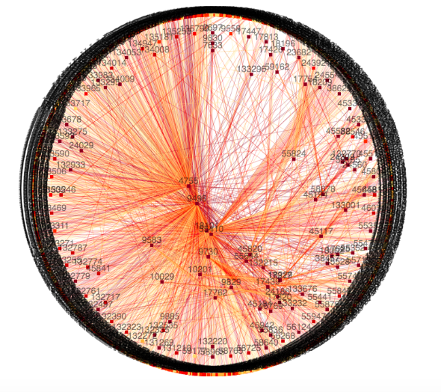
Autonomous System Graph for India
Source: https://labs.apnic.net/vizas/#IN

Slide 11
Internet Architecture
Internet Service Providers (ISP) – An AS provides Internet connectivity to another group of ASes or end users

Slide 12
Peering between ISPs

Slide 13
Communication between Two Nodes over ISPs

Slide 14
IP Addressing – Basic Principles
We need to forward data packets from one network to another network via different intermediate networks.
Host 2
AS 11
AS 10
AS 12
Host 1
AS 13

Slide 15
IP Addressing – Basic Principles
The address should identify a network as well as a host inside a network
Host 2
AS 11
AS 10
AS 12
Host 1
AS 13

Slide 16
IP Addressing
Network address
Host address
Divide the address space (32 bit in IPv4) among network address and host address
The old age – Classful addressing: Fixed number of bits for network address and host address

Slide 17
Classful Addressing
How to identify a class – use the first few bits
0 – Class A, 10 – Class B, 110 – Class C, 1110 – Class D, 1111 – Class E

Slide 18
Network Address and Broadcast Address
Network address – identify a network
All 0’s in the host address part
Ex-1 (Class A): 01111110.00000000.00000000.00000000 (126.0.0.0)
Ex-2 (Class B): 10111101.11101001.00000000.00000000 (189.233.0.0)
Broadcast address – send the data to all the hosts of a network
All 1’s in the host address part
Ex-1 (Class A): 01111110.11111111.11111111.11111111 (126.255.255.255)
Ex-2 (Class B): 10111101.11101001.11111111.11111111 (189.233.255.255)
How many valid hosts can be there in a Class A, in a Class B and in a Class C IP address?

Slide 19
Subnetting and Supernetting – Classless Inter-domain Routing (CIDR)
You have 255 hosts in a network. Which IPv4 address class will you use – Class C or Class B ?
Class C – not possible
Class B – huge address space is lost (using only 255 addresses out of possible 2¹⁶-2 addresses)
Split a large network or combine multiple small networks for efficient use of address space
Subnetting – divide a large network into multiple small networks
Supernetting – combine multiple small networks into a single large network
Subnet mask – denote the number of bits in the network address field

Slide 20
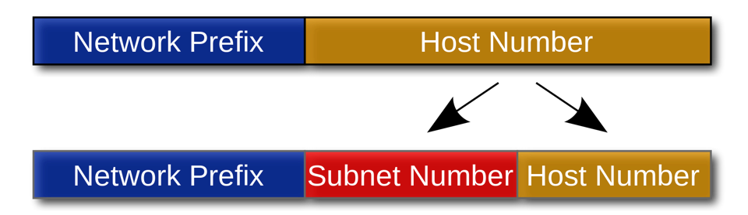
Divide a Network into Subnets

Slide 21
CIDR – Addressing Format
Subnet Address
Host Address
IP Address
10111111
10110100
01010011
11101011
Netmask
11111111
11110000
00000000
00000000
We write the IP address as 191.180.83.235/12 in CIDR notation
The first 12 bits are the network address and rest (32-12)=20 bits are for host address
The subnet mask is 255.240.0.0

Slide 22
CIDR - Manual IP Setting in the OS

Slide 23
Divide a Network into Subnets
Let the IP address of a network is 203.110.0.0/16
We want to divide this network into three subnets
We need 3 bits for subnets – why not 2 bits?
Subnet 1 – 100, Subnet 2– 101, Subnet 3 – 110
Rest 13 bits are used for addressing the hosts of those subnets.
The subnets are – 203.110.128.0/19, 203.110.160.0/19, 203.110.192.0/19

Slide 24


All Zero and All One Subnets
192.168.0.0/16
192.168.128.0/17
192.168.1XXXXXXX.X
192.168.0.0/17
192.168.0XXXXXXX.X
Broadcast address for this subnet is 192.168.255.255, broadcast address for the original network is also 192.168.255.255 – All-One Subnet
The network address for the subnet and the original network is identical – Subnet Zero
We normally avoid “all zero” and “all one” subnets.

Slide 25
CIDR Example
CSE – 2000 Hosts
VGSOM – 500 Hosts
EE – 500 Hosts
203.110.0.0/19

Slide 26
CIDR Example
CSE – 2000 Hosts
VGSOM – 500 Hosts
EE – 500 Hosts
9 bit hosts
9 bit hosts
11 bit hosts
203.110.0.0/19

Slide 27
CIDR Example
Address space – 203.110.0.0/19
13 bits are available to serve all the hosts of IITKGP network
We need to divide these address space among 3 subnets
CSE – 11 bits, VGSOM – 9 bits, EE – 9 bits for host address
We have 2 bits left for identifying three subnets – Is this possible?
Avoid “all zero” and ”all one” subnets
Let us apply CIDR – Combine VGSOM and EE Networks together

Slide 28
CIDR Example
CSE – 2000 Hosts
VGSOM – 500 Hosts
9 bit hosts
EE – 500 Hosts
9 bit hosts
11 bit hosts
10 bit hosts
203.110.0.0/19

Slide 29
CIDR Example
CSE – 11 bits, VGSOM+EE – 10 bits
Network address – 203.110.0.0/19, 203.110.000XXXXX.XXXXXXXX
CSE network address 203.110.00010XXX.XXXXXXXX (203.110.16.0/21)
VGSOM+EE network address 203.110.00001XXX.XXXXXXXX (203.110.8.0/21)

Slide 30
CIDR Example
CSE – 2000 Hosts
VGSOM – 500 Hosts
9 bit hosts
EE – 500 Hosts
9 bit hosts
11 bit hosts
203.110.16.0/21
10 bit hosts
203.110.8.0/21
203.110.0.0/19

Slide 31
CIDR Example
VGSOM – 9 bits, EE – 9 bits
Network address – 203.110.8.0/21, 203.110.00001XXX.XXXXXXXX
VGSOM network address 203.110.0000110X.XXXXXXXX (203.110.12.0/23)
EE network address 203.110.0000101X.XXXXXXXX (203.110.10.0/23)

Slide 32
CIDR Example
CSE – 2000 Hosts
VGSOM – 500 Hosts
9 bit hosts
EE – 500 Hosts
9 bit hosts
11 bit hosts
203.110.12.0/23
203.110.10.0/23
203.110.16.0/21
10 bit hosts
203.110.8.0/21
203.110.0.0/19

Slide 33

CIDR – Routing Table Construction
10.0.2.0/24
R3
172.16.1.1/24
172.16.1.2/24
10.0.2.1/24
eth0
10.0.3.1/24
10.0.3.0/24
172.16.2.2/24
R2
R1
eth1
172.16.2.1/24
10.0.4.1/24
10.0.4.0/24
Network | Netmask | Gateway | Interface
10.0.2.0 | 255.255.255.0 | 172.16.2.2 | eth1
10.0.3.0 | 255.255.255.0 | 172.16.2.2 | eth1
10.0.4.0 | 255.255.255.0 | 172.16.2.2 | eth1
0.0.0.0 | 0.0.0.0 | 172.16.1.1 | eth0
172.16.1.0 | 255.255.255.0 | 172.16.1.1 | eth0
172.16.2.0 | 255.255.255.0 | 172.16.2.2 | eth1
Routing Table for R1

Slide 34
CIDR – Routing Table Construction
10.0.2.0/24
R3
172.16.1.1/24
172.16.1.2/24
10.0.2.1/24
eth0
10.0.3.1/24
10.0.3.0/24
172.16.2.2/24
R2
R1
eth1
172.16.2.1/24
10.0.4.1/24
Routing Table for R1
10.0.4.0/24
Network | Netmask | Gateway | Interface
10.0.2.0 | 255.255.255.0 | 172.16.2.2 | eth1
10.0.3.0 | 255.255.255.0 | 172.16.2.2 | eth1
10.0.4.0 | 255.255.255.0 | 172.16.2.2 | eth1
0.0.0.0 | 0.0.0.0 | 172.16.1.1 | eth0
172.16.1.0 | 255.255.255.0 | 172.16.1.1 | eth0
172.16.2.0 | 255.255.255.0 | 172.16.2.2 | eth1
Compaction of routing table is possible

Slide 35
CIDR – Routing Table Construction
10.0.2.0/24
R3
172.16.1.1/24
172.16.1.2/24
10.0.2.1/24
eth0
10.0.3.1/24
10.0.3.0/24
172.16.2.2/24
R2
R1
eth1
172.16.2.1/24
10.0.4.1/24
10.0.4.0/24
Network | Netmask | Gateway | Interface
10.0.0.0 | 255.255.0.0 | 172.16.2.2 | eth1
0.0.0.0 | 0.0.0.0 | 172.16.1.1 | eth0
172.16.1.0 | 255.255.255.0 | 172.16.1.1 | eth0
172.16.2.0 | 255.255.255.0 | 172.16.2.2 | eth1
Compact
Routing Table for R1

Slide 36


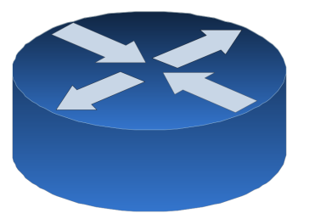
CIDR – Problem of Multihoming
10.0.2.0/24
R3
172.16.1.1/24
172.16.1.2/24
10.0.2.1/24
eth0
10.0.3.1/24
10.0.3.0/24
172.16.2.2/24
R2
R1
eth1
172.16.2.1/24
10.0.4.1/24
eth2
10.0.4.0/24
172.16.3.1/24
10.0.4.2/24
172.16.3.2/24

Slide 37
CIDR – Longest Prefix Match
Supernetting is not always perfect !
There is always a possibility of duplicate entries
Network | Netmask | Gateway | Interface
10.0.0.0 | 255.255.0.0 | 172.16.2.2 | eth1
10.0.4.0 | 255.255.255.0 | 172.16.3.2 | eth2
0.0.0.0 | 0.0.0.0 | 172.16.1.1 | eth0
172.16.1.0 | 255.255.255.0 | 172.16.1.1 | eth0
172.16.2.0 | 255.255.255.0 | 172.16.2.2 | eth1
Where to forward 10.0.4.8 ?

Slide 38
CIDR – Longest Prefix Match
Use Patricia Tree (a compact representation of trie) for matching prefixes.
0
1
00
10
11
0*
00*
100
101
11*

Slide 39
Next, we’ll look how to construct the routing table for the Internet …

